Slide 1
Omega-X Common Semantic Data Model- Flexibility Application Ontology
Workshops
Fatma-Zohra Hannou
EDF R&D
16/02/2024

Slide 2
Omega-X Common Semantic Data Model- Flexibility Application Ontology
Workshop #1
Fatma-Zohra Hannou
EDF R&D
16/02/2024

Slide 3




Outline
Semantic Interoperability
Business and System Use Cases
Omega-X CSDM
Event & Time Series
Energy Data Sets
Recall of CSDM Demo on Maia Dataset
Extension for BUC3.0
Next Steps

Slide 4




Semantic Interoperability
The purpose of semantic interoperability within dataspaces is to ensure that data consumer and provider have a common understanding of shared data.
To support semantic interoperability, a common knowledge representation is created,
including data models that represent multiple dimensions of energy datasets
Use Case Context
Energy Domain Attributes
A methodology for creating the Common Semantic Data Model (CSDM)
has been defined. AIME (Agile Interaction model-based Methodology for
Energy dataspaces).
Top-Level Structure
Focus on agility for capturing energy domain interaction models, and aligning to energy domain standards (IEC CIM, IEC 61850,…)
The methodology aims also to ensure adherence to FAIR data principles (Energy Data Act)
Standard
Notes:
Semantic inter

Slide 5


















Data Pipelining in Omega-X
Quality Report
Semantic Validation
(SHACL, Reasoner, ..)
Publish
Publish
Data Consumer
Data Exchange
Knowledge Graph
Semantify
Semantify
Syntactic Validation
Conforms to
Ontology
Data Storage
Data Provider
Notes:
Usage of CSDM modules EDS et
Data Storage ?

Slide 6
Business and System UCs
BUC Flex1.0 Flexibility for internal optimization
BUC Flex2.0 Flexibility for congestion management with bilateral contracts
BUC Flex3.0 Flexibility for capacity management with market structures
BUC / SUC | Full description in template | Diagrams (activity/sequence) | Data model and role Model
1 Flex. for internal optimization | Done | Activity | Yes
2 Flex. for congestion mgmt with bilateral contracts | Done | Activity | Yes
3 Flex. for capacity mgmt with market structures | Done | Activity | Yes
Passive Consumption Baseline Training 1 | Done | Sequence | Yes
Intermittent DER Baseline Training 1 | Done | Sequence | Yes
Controllable Resource Training 1 | Done | Sequence | Yes
Passive Consumption Baseline Prediction 1 | Done | Sequence | Yes
Intermittent DER Baseline Prediction 1 | Done | Sequence | Yes
Implicit Flex Activation 1 | Done | Sequence | Yes
Flex Option Orders Creation 2 | Done | Sequence | Yes

Slide 7
Business and System UCs
BUC Flex1.0 Flexibility for internal optimization
BUC Flex2.0 Flexibility for congestion management with bilateral contracts
BUC Flex3.0 Flexibility for capacity management with market structures
BUC / SUC | Full description in template | Diagrams (activity/sequence) | Data model and role Model
Grid observability & flex schedule training 2 | To be completed* | Sequence | Yes
Grid observability & flex schedule operation 2 | To be completed* | Sequence | Yes
Planning 2 | To be completed* | Sequence | Yes
Collaborative flexibility 2 | To be completed* | Sequence | Yes
Bidding Zone Creation 3 | To be completed* | Sequence | Yes
Aggregate Baseline Bidding Zone 3 | Done | Sequence | Yes
Flex Requests Creation 3 | Done | Sequence | Yes
Flex Offers Creation 3 | Done | Sequence | Yes
Flex Market Orders Creation 3 | Done | Sequence | Yes
Flex Order Disaggregation 3 | Done | Sequence | Yes
* Respective sequence diagram lacking

Slide 8


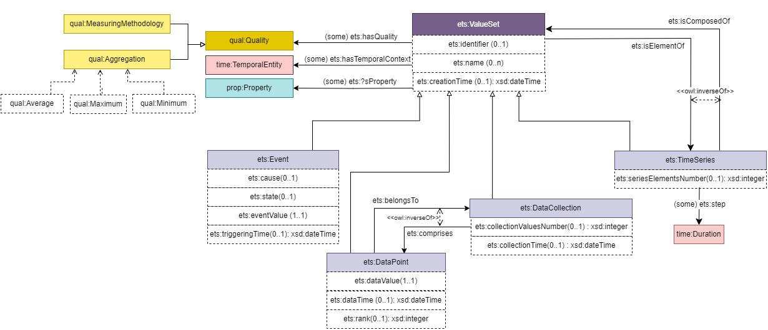





Events & Time Series
The Top level ontology provides a common knwoledge representation at the global structure level. This enables identifying value sets’ common structures and related temporal coverage aspects.
Event & Time Series
Event
Data collection
Time series
Temporal aspects
Validity Context
Real world time
Creation time
Quality aspects
Aggregation
Measuring Method (prediction, measured)
Notes:
Usage of CSDM modules EDS et
Data Storage ?

Slide 9


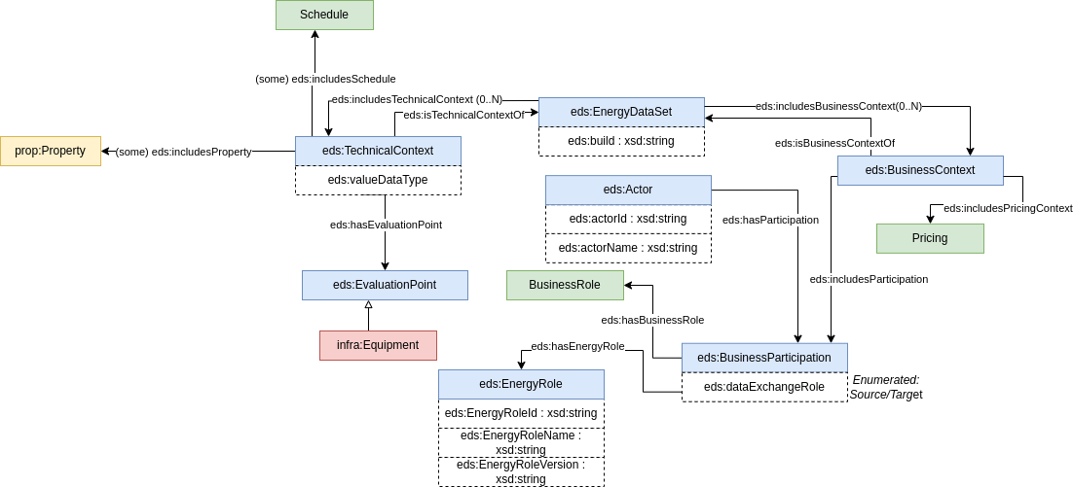


Energy Data Sets
The Energy data set ontology provides a common knowledge representation of the context where the exchange of energy data takes place.
Technical Context
Evaluation Point
Meteo Station
PV Plant
Property
Ambient Temperature
Solar Irradiance
Energy Produced
Units
degree Celsius
watts per square meter [W/m2]
Kilo Watt hour (kWh)
Business Context
Source Actor
Target Actor
Data Provider
Service Provider
MAIA Municipality
Tecnalia
Notes:
Usage of CSDM modules EDS et
Data Storage ?

Slide 10
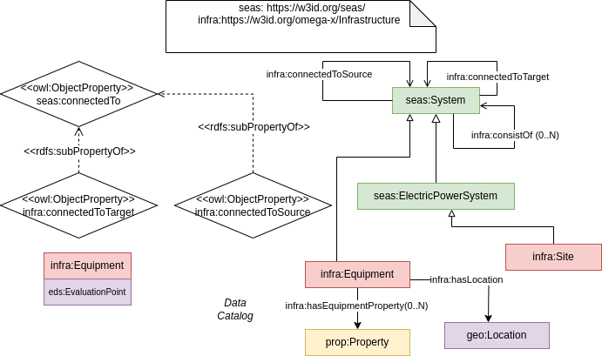
Infrastructure
Infrastructure module based on seas ontology.
Notes:
Usage of CSDM modules EDS et
Data Storage ?

Slide 11
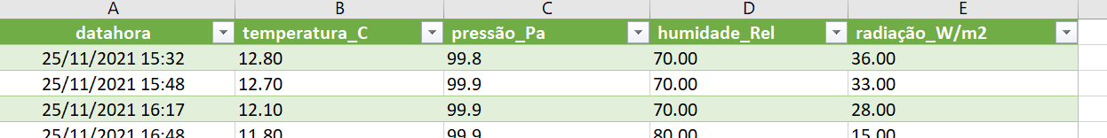
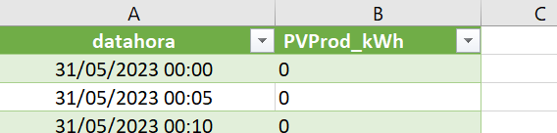
CSDM Demo on Maia
# Energy production Time Series
:MaiaEnergyProd a ets:TimeSeries, ets:ValueSet, eds:eds:EnergyDataSet ;
ets:temporalContext :MaiaEnergyprodCoverage ;
eds:includesTechnicalContext :MaiaEnergyProdTC ;
eds:includesBusinessContext :MaiaEnergyBC . # Location
:GueifãesControlSystemLocation
a schema:PostalAddress ;
schema:addressCountry "Portugal" ;
schema:addressRegion "Maia" ;
schema:addressLocality "Piscinas Municipais de Gueifães" ;
geo:lat "41.215143" ;
geo:long "-8.600758" . # Temporal Context
:MaiaEnergyprodCoverage a time:Interval ;
time:hasBeginning [a time:Instant ; time:inXSDDateTimeStamp "2021-01-01T00:00:00"^^xsd:dateTimeStamp ] ;
time:hasDurationDescription [ a time:DurationDescription ; :years "1"^^xsd:integrer] . # Evaluation Point
:GueifãesControlSystem a eds:EvaluationPoint ;
eds:hasLocation :GueifãesControlSystemLocation . # Technical Context
:MaiaEnergyProdTC a eds:TechnicalContext ;
eds:hasEvaluationPoint :GueifãesControlSystem ;
eds:includesProperty :energyProduction . # Business Context
:MaiaEnergyBC a eds:BusinessContext .
Maia Dataset
Static Data
These values are captured by a meteorological station (ATMOS 41, cf. datasheet, located in "Cobertura Verde" (Lat: 41.234158, Lng: -8.623050), and updated to Maia Municipality data lake every 15.
These values are collected by the control system (located in "Piscinas Municipais de Gueifães" (Lat: 41.215143, Lng: -8.600758), and every day, by 10AM, we receive an email with a link for a xls file with the data from the previous day. This email is processed around 12AM, and, thus, by 12AM the data lake
Dynamic Data
Notes:
Usage of CSDM modules EDS et
Data Storage ?

Slide 12
CSDM Demo on Maia
Maia Dataset
maia:MaiaEnergyProd ets:isComposedOf [
a ets:dataPoint;
ets:dataValue "721.98";
ets:dataTime "2023-08-15T10:00:00"^^xsd:dateTime
], [
a ets:dataPoint;
ets:dataValue "522.61";
ets:dataTime "2023-08-15T10:15:00"^^xsd:dateTime
], [
a ets:dataPoint;
ets:dataValue "473.51";
ets:dataTime "2023-08-15T10:30:00"^^xsd:dateTime
], [
a ets:dataPoint;
ets:dataValue "94.78";
ets:dataTime "2023-08-15T10:45:00"^^xsd:dateTime
], [
a ets:dataPoint;
ets:dataValue "551.71";
ets:dataTime "2023-08-15T11:00:00"^^xsd:dateTime
], [
a ets:dataPoint;
ets:dataValue "610.56";
ets:dataTime "2023-08-15T11:15:00"^^xsd:dateTime
Static Data
These values are captured by a meteorological station (ATMOS 41, cf. datasheet, located in "Cobertura Verde" (Lat: 41.234158, Lng: -8.623050), and updated to Maia Municipality data lake every 15.
These values are collected by the control system (located in "Piscinas Municipais de Gueifães" (Lat: 41.215143, Lng: -8.600758), and every day, by 10AM, we receive an email with a link for a xls file with the data from the previous day. This email is processed around 12AM, and, thus, by 12AM the data lake
Dynamic Data
Notes:
Usage of CSDM modules EDS et
Data Storage ?

Slide 13
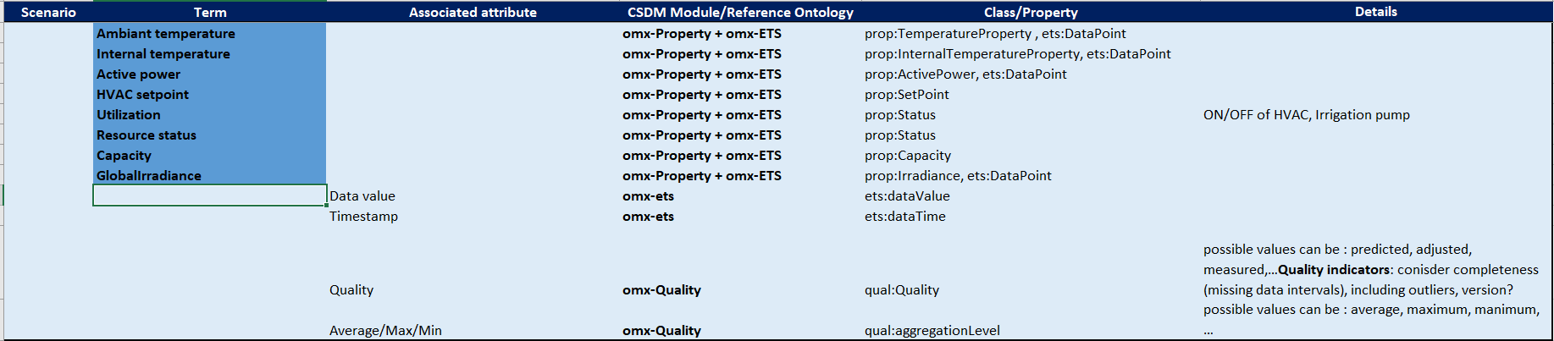
Modeling Scope
Properties
Notes:
Usage of CSDM modules EDS et
Data Storage ?

Slide 14
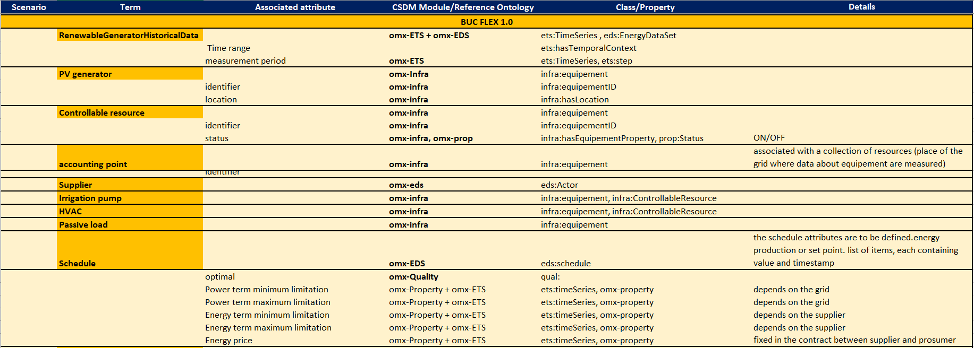
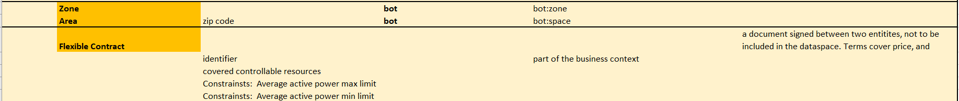
Modeling Scope
BUC 1.0
Notes:
Usage of CSDM modules EDS et
Data Storage ?

Slide 15
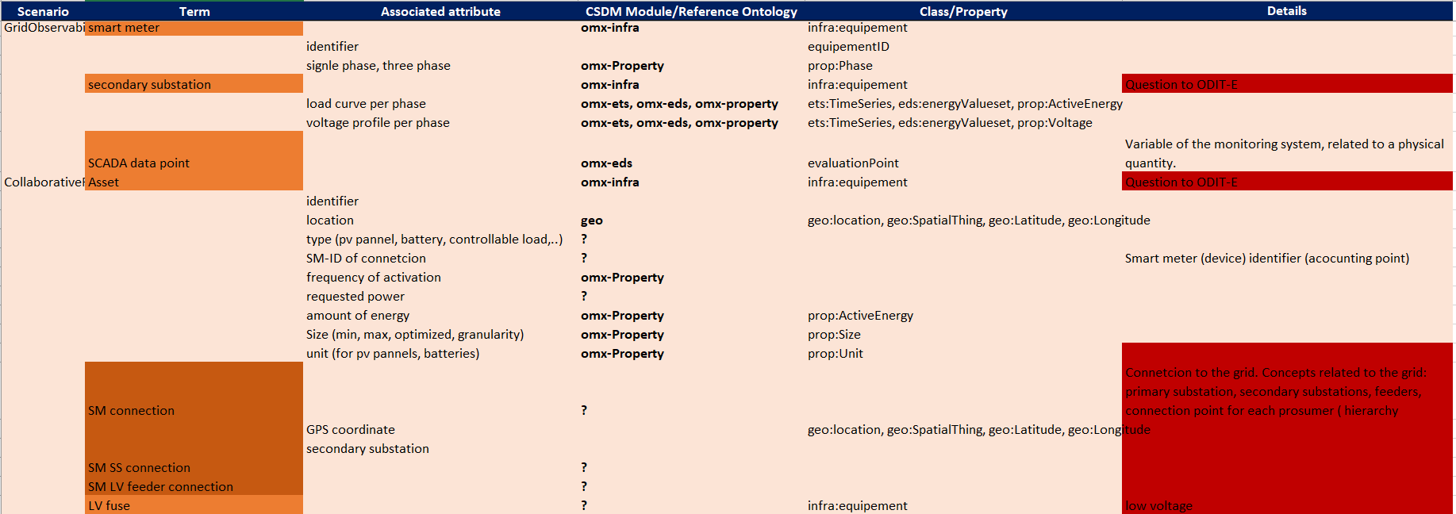
Modeling Scope
BUC 2.0
Notes:
Usage of CSDM modules EDS et
Data Storage ?

Slide 16
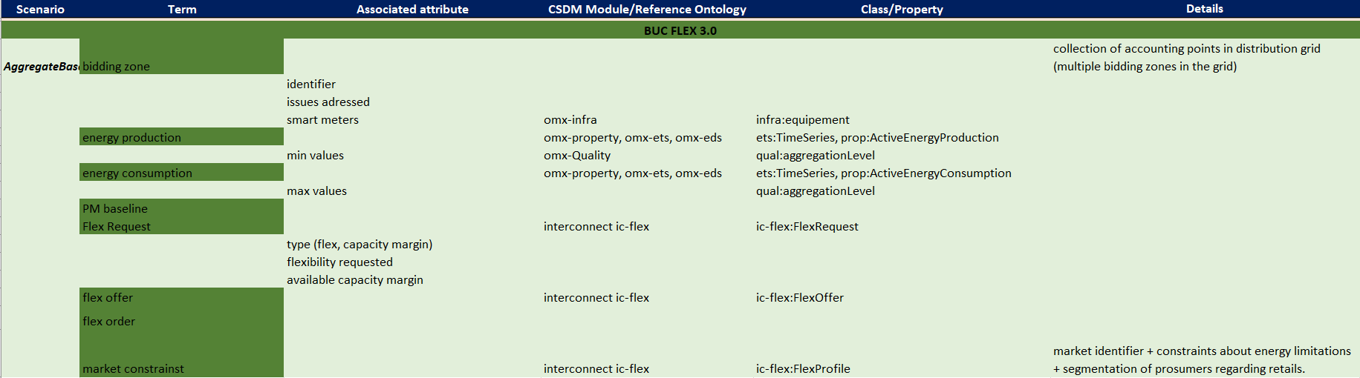
Modeling Scope
BUC 3.0
Notes:
Usage of CSDM modules EDS et
Data Storage ?

Slide 17
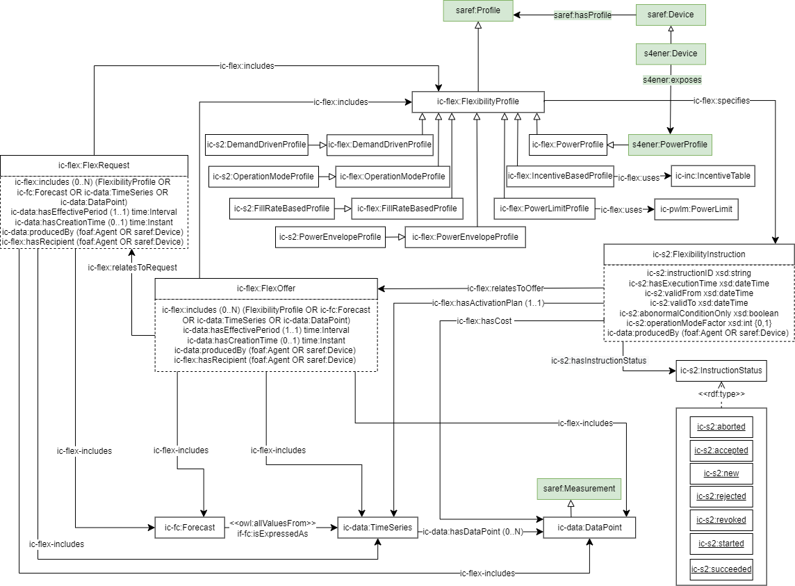
Interconncet Ontology
https://gitlab.inesctec.pt/interconnect-public/ontology
Notes:
Usage of CSDM modules EDS et
Data Storage ?

Slide 18


Next Steps
Action | Action Name | Partner | Status
A1 | Complete the mapping table based on session #1 | EDF
A2 | Check Interconnect Flexibility module adequacy for market and contract modelling (slide #16) | ALL
A3 | Additional data ? Files ? | ODIT-E, EDP, Tecnalia, IPMAIA
A4 | CSDM iteration to create the Flexbility module | EDF
A5 | Send Doodle for Next workshop session | EDF
A6 | Fill Doodle | ALL
Notes:
Usage of CSDM modules EDS et
Data Storage ?

Slide 19
Omega-X Common Semantic Data Model- Flexibility Application Ontology
Workshop #2
Fatma-Zohra Hannou
EDF R&D
13/03/2024

Slide 20
Outline
Semantic Interoperability
Business and System Use Cases
Omega-X CSDM
Event & Time Series
Energy Data Sets
Infrastructure
GoT and Modeling attempts
Next Steps

Slide 21
Semantic Interoperability
The purpose of semantic interoperability within dataspaces is to ensure that data consumer and provider have a common understanding of shared data.
To support semantic interoperability, a common knowledge representation is created,
including data models that represent multiple dimensions of energy datasets
Use Case Context
Energy Domain Attributes
A methodology for creating the Common Semantic Data Model (CSDM)
has been defined. AIME (Agile Interaction model-based Methodology for
Energy dataspaces).
Top-Level Structure
Focus on agility for capturing energy domain interaction models, and aligning to energy domain standards (IEC CIM, IEC 61850,…)
The methodology aims also to ensure adherence to FAIR data principles (Energy Data Act)
Standard
Notes:
Semantic inter

Slide 22
Data Pipelining in Omega-X
Quality Report
Semantic Validation
(SHACL, Reasoner, ..)
Publish
Publish
Data Consumer
Data Exchange
Knowledge Graph
Semantify
Semantify
Syntactic Validation
Conforms to
Ontology
Data Storage
Data Provider
Notes:
Usage of CSDM modules EDS et
Data Storage ?

Slide 23
Business and System UCs
BUC Flex1.0 Flexibility for internal optimization
BUC Flex2.0 Flexibility for congestion management with bilateral contracts
BUC Flex3.0 Flexibility for capacity management with market structures
BUC / SUC | Full description in template | Diagrams (activity/sequence) | Data model and role Model
1 Flex. for internal optimization | Done | Activity | Yes
2 Flex. for congestion mgmt with bilateral contracts | Done | Activity | Yes
3 Flex. for capacity mgmt with market structures | Done | Activity | Yes
Passive Consumption Baseline Training 1 | Done | Sequence | Yes
Intermittent DER Baseline Training 1 | Done | Sequence | Yes
Controllable Resource Training 1 | Done | Sequence | Yes
Passive Consumption Baseline Prediction 1 | Done | Sequence | Yes
Intermittent DER Baseline Prediction 1 | Done | Sequence | Yes
Implicit Flex Activation 1 | Done | Sequence | Yes
Flex Option Orders Creation 2 | Done | Sequence | Yes

Slide 24
Business and System UCs
BUC Flex1.0 Flexibility for internal optimization
BUC Flex2.0 Flexibility for congestion management with bilateral contracts
BUC Flex3.0 Flexibility for capacity management with market structures
BUC / SUC | Full description in template | Diagrams (activity/sequence) | Data model and role Model
Grid observability & flex schedule training 2 | To be completed* | Sequence | Yes
Grid observability & flex schedule operation 2 | To be completed* | Sequence | Yes
Planning 2 | To be completed* | Sequence | Yes
Collaborative flexibility 2 | To be completed* | Sequence | Yes
Bidding Zone Creation 3 | To be completed* | Sequence | Yes
Aggregate Baseline Bidding Zone 3 | Done | Sequence | Yes
Flex Requests Creation 3 | Done | Sequence | Yes
Flex Offers Creation 3 | Done | Sequence | Yes
Flex Market Orders Creation 3 | Done | Sequence | Yes
Flex Order Disaggregation 3 | Done | Sequence | Yes
* Respective sequence diagram lacking

Slide 25
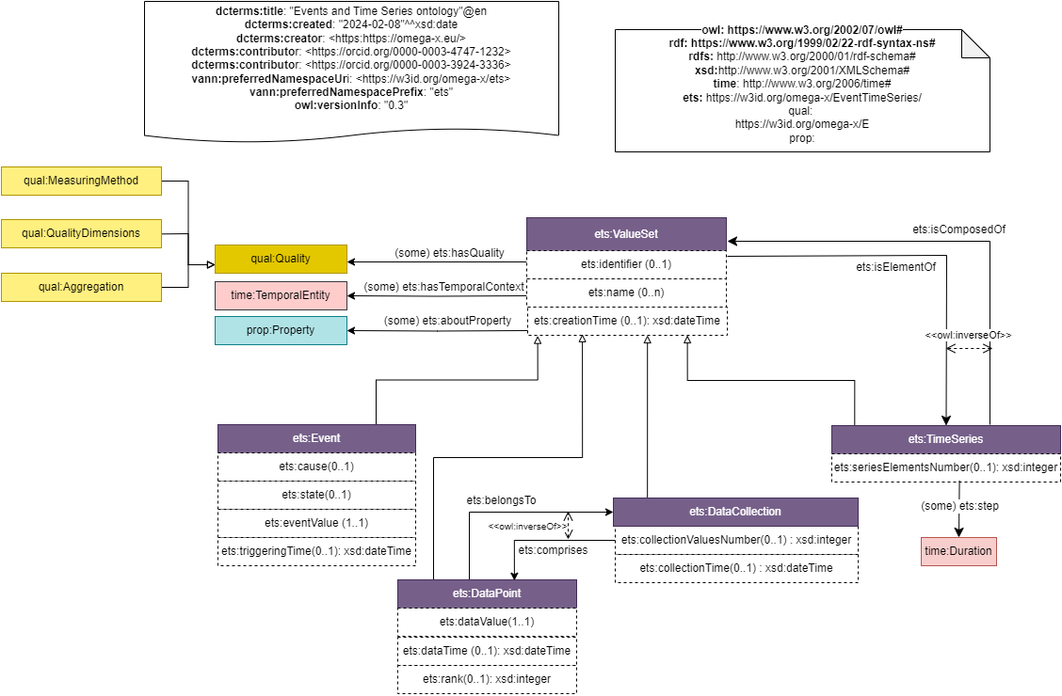
Events & Time Series
The Top level ontology provides a common knwoledge representation at the global structure level. This enables identifying value sets’ common structures and related temporal coverage aspects.
Notes:
Usage of CSDM modules EDS et
Data Storage ?

Slide 26
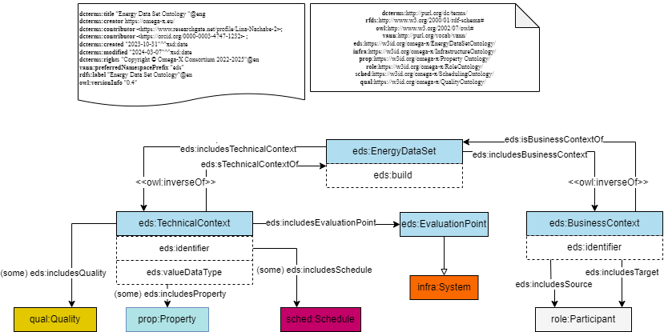
Energy Data Sets
The Energy data set ontology provides a common knowledge representation of the context where the exchange of energy data takes place.
Notes:
Usage of CSDM modules EDS et
Data Storage ?

Slide 27
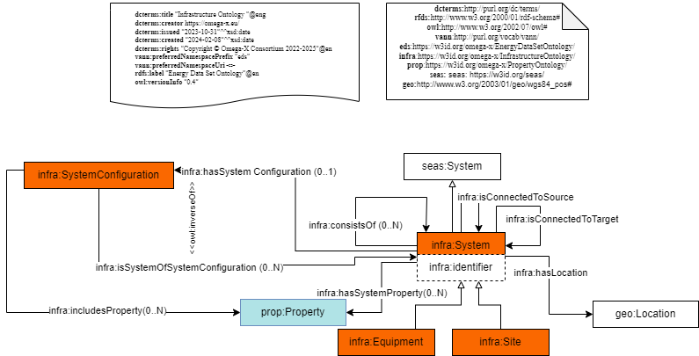
Infrastructure
Infrastructure module based on seas ontology.
Notes:
Usage of CSDM modules EDS et
Data Storage ?

Slide 28

Glossary of Terms
Notes:
Usage of CSDM modules EDS et
Data Storage ?

Slide 29
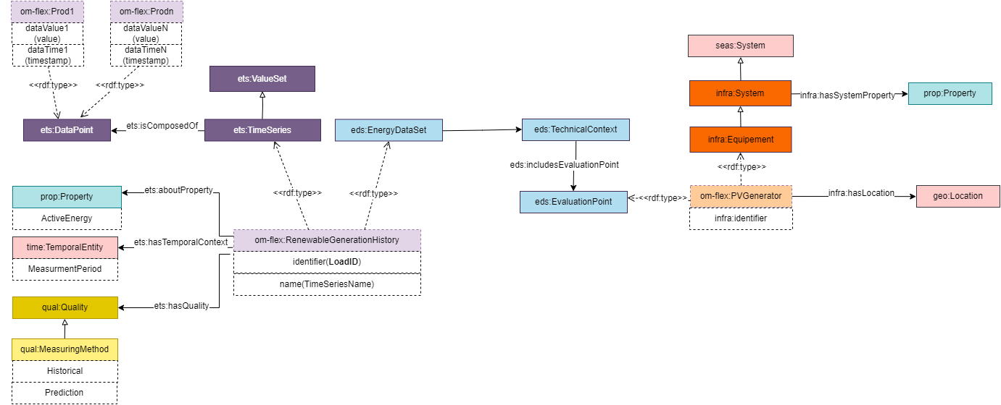
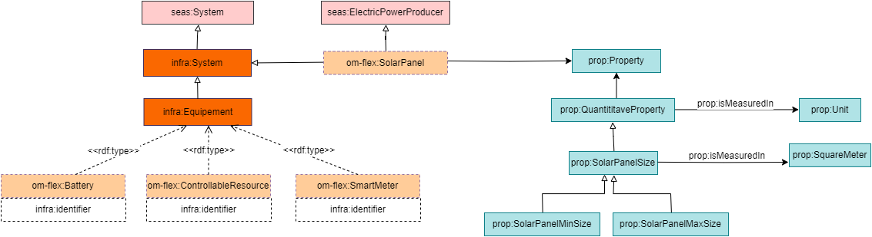
Modeling Attempts
Notes:
Usage of CSDM modules EDS et
Data Storage ?

Slide 30
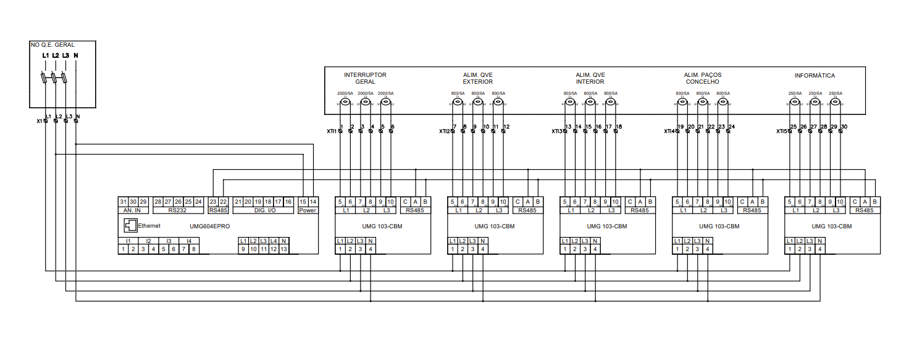
Smart Meter Connection
Notes:
Usage of CSDM modules EDS et
Data Storage ?

Slide 31
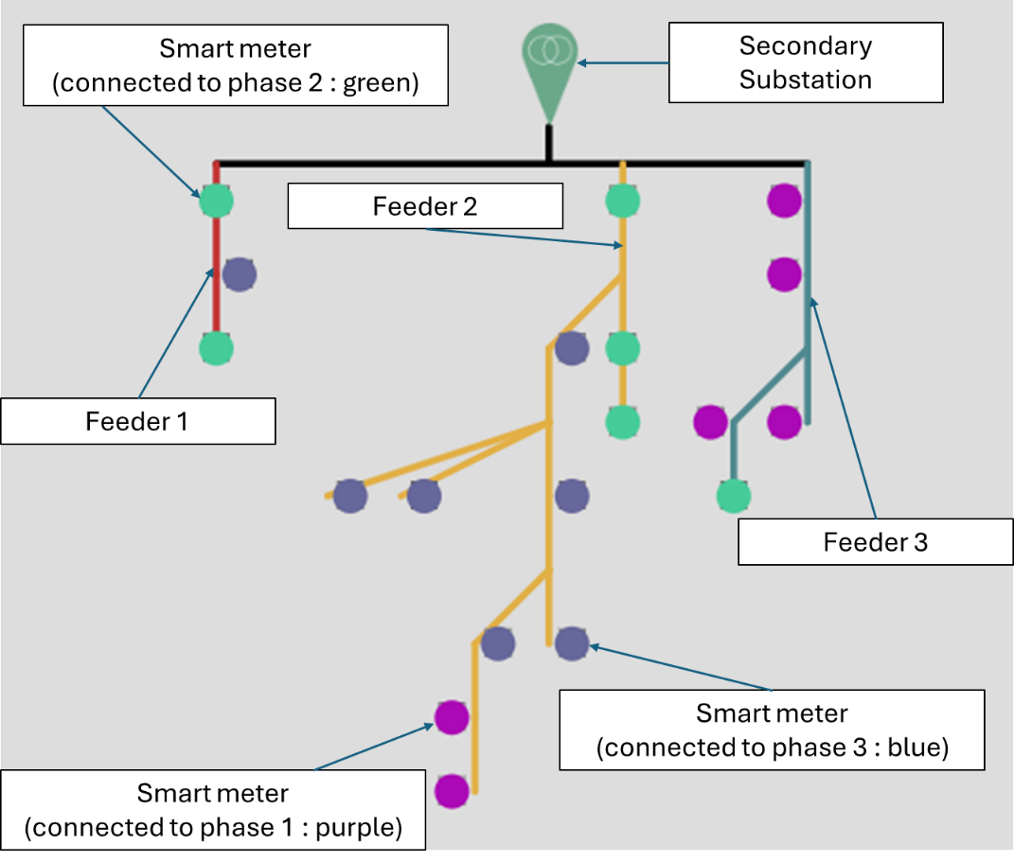
Smart Meter Connection
Notes:
Usage of CSDM modules EDS et
Data Storage ?

Slide 32
Interconncet Ontology
https://gitlab.inesctec.pt/interconnect-public/ontology
Notes:
Usage of CSDM modules EDS et
Data Storage ?

Slide 33
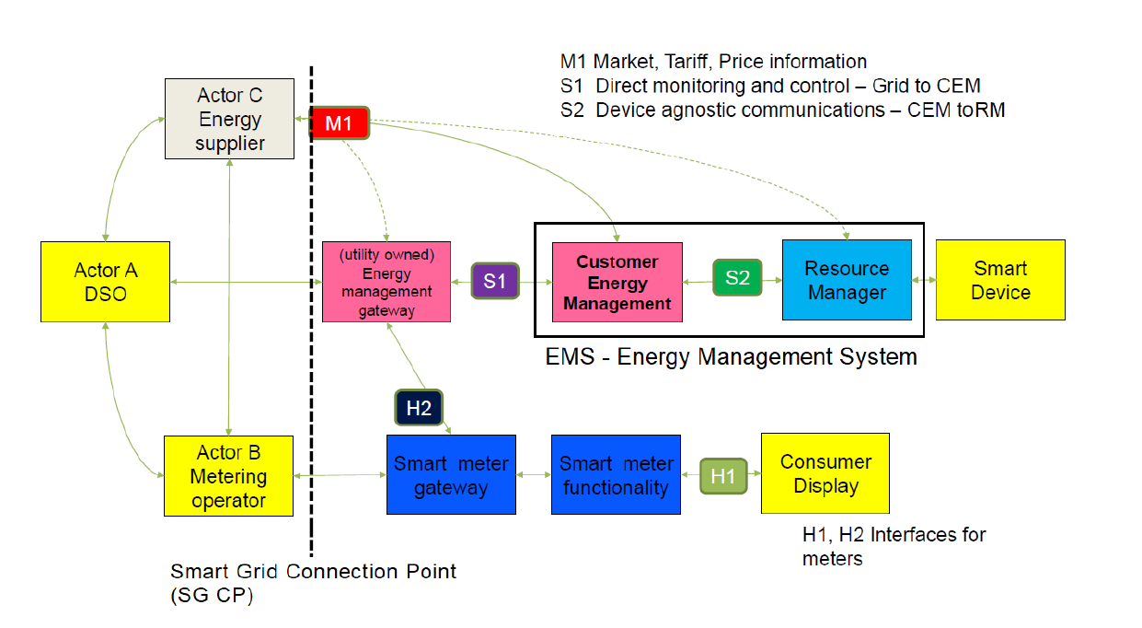
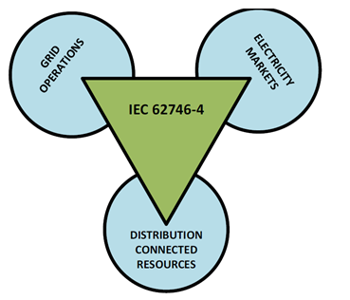
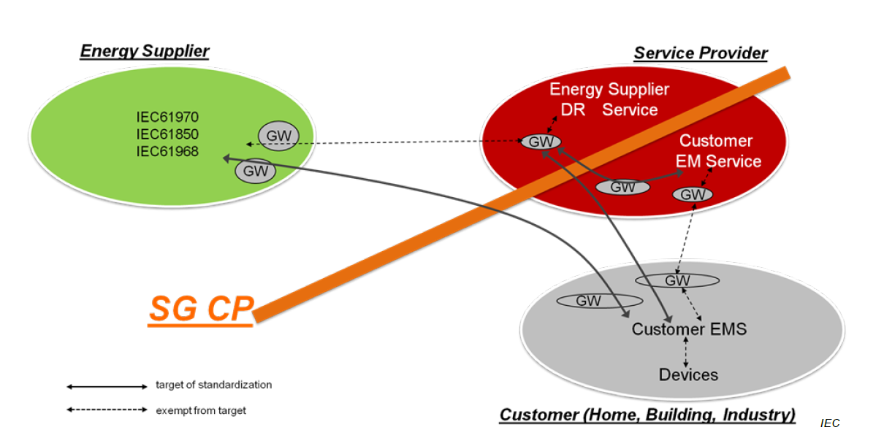
IEC 62746

Slide 34
CSDM Demo on Maia
# Energy production Time Series
:MaiaEnergyProd a ets:TimeSeries, ets:ValueSet, eds:eds:EnergyDataSet ;
ets:temporalContext :MaiaEnergyprodCoverage ;
eds:includesTechnicalContext :MaiaEnergyProdTC ;
eds:includesBusinessContext :MaiaEnergyBC . # Location
:GueifãesControlSystemLocation
a schema:PostalAddress ;
schema:addressCountry "Portugal" ;
schema:addressRegion "Maia" ;
schema:addressLocality "Piscinas Municipais de Gueifães" ;
geo:lat "41.215143" ;
geo:long "-8.600758" . # Temporal Context
:MaiaEnergyprodCoverage a time:Interval ;
time:hasBeginning [a time:Instant ; time:inXSDDateTimeStamp "2021-01-01T00:00:00"^^xsd:dateTimeStamp ] ;
time:hasDurationDescription [ a time:DurationDescription ; :years "1"^^xsd:integrer] . # Evaluation Point
:GueifãesControlSystem a eds:EvaluationPoint ;
eds:hasLocation :GueifãesControlSystemLocation . # Technical Context
:MaiaEnergyProdTC a eds:TechnicalContext ;
eds:hasEvaluationPoint :GueifãesControlSystem ;
eds:includesProperty :energyProduction . # Business Context
:MaiaEnergyBC a eds:BusinessContext .
Maia Dataset
Static Data
These values are captured by a meteorological station (ATMOS 41, cf. datasheet, located in "Cobertura Verde" (Lat: 41.234158, Lng: -8.623050), and updated to Maia Municipality data lake every 15.
These values are collected by the control system (located in "Piscinas Municipais de Gueifães" (Lat: 41.215143, Lng: -8.600758), and every day, by 10AM, we receive an email with a link for a xls file with the data from the previous day. This email is processed around 12AM, and, thus, by 12AM the data lake
Dynamic Data
Notes:
Usage of CSDM modules EDS et
Data Storage ?

Slide 35
CSDM Demo on Maia
Maia Dataset
maia:MaiaEnergyProd ets:isComposedOf [
a ets:dataPoint;
ets:dataValue "721.98";
ets:dataTime "2023-08-15T10:00:00"^^xsd:dateTime
], [
a ets:dataPoint;
ets:dataValue "522.61";
ets:dataTime "2023-08-15T10:15:00"^^xsd:dateTime
], [
a ets:dataPoint;
ets:dataValue "473.51";
ets:dataTime "2023-08-15T10:30:00"^^xsd:dateTime
], [
a ets:dataPoint;
ets:dataValue "94.78";
ets:dataTime "2023-08-15T10:45:00"^^xsd:dateTime
], [
a ets:dataPoint;
ets:dataValue "551.71";
ets:dataTime "2023-08-15T11:00:00"^^xsd:dateTime
], [
a ets:dataPoint;
ets:dataValue "610.56";
ets:dataTime "2023-08-15T11:15:00"^^xsd:dateTime
Static Data
These values are captured by a meteorological station (ATMOS 41, cf. datasheet, located in "Cobertura Verde" (Lat: 41.234158, Lng: -8.623050), and updated to Maia Municipality data lake every 15.
These values are collected by the control system (located in "Piscinas Municipais de Gueifães" (Lat: 41.215143, Lng: -8.600758), and every day, by 10AM, we receive an email with a link for a xls file with the data from the previous day. This email is processed around 12AM, and, thus, by 12AM the data lake
Dynamic Data
Notes:
Usage of CSDM modules EDS et
Data Storage ?

Slide 36
Next Steps
Action | Action Name | Partner | Status
A1 | Complete the mapping table based on session #2 | EDF
A2 | Data about grid topology | EDF
A3 | CSDM second iteration to create the Flexbility module | EDF
A4 | Choose together a date for the next session | ALL
Notes:
Usage of CSDM modules EDS et
Data Storage ?

Slide 37
Omega-X Common Semantic Data Model- Flexibility Application Ontology
Workshop #3
Fatma-Zohra Hannou
EDF R&D
25/03/2024

Slide 38
Outline
Flexibility UCF Ontology
Flexibility Operations
Flexibility Infrastructure
Flexibility Properties
Examples of UC Data Mappings
Grid Observability Historical Data
Maia Demo

Slide 39
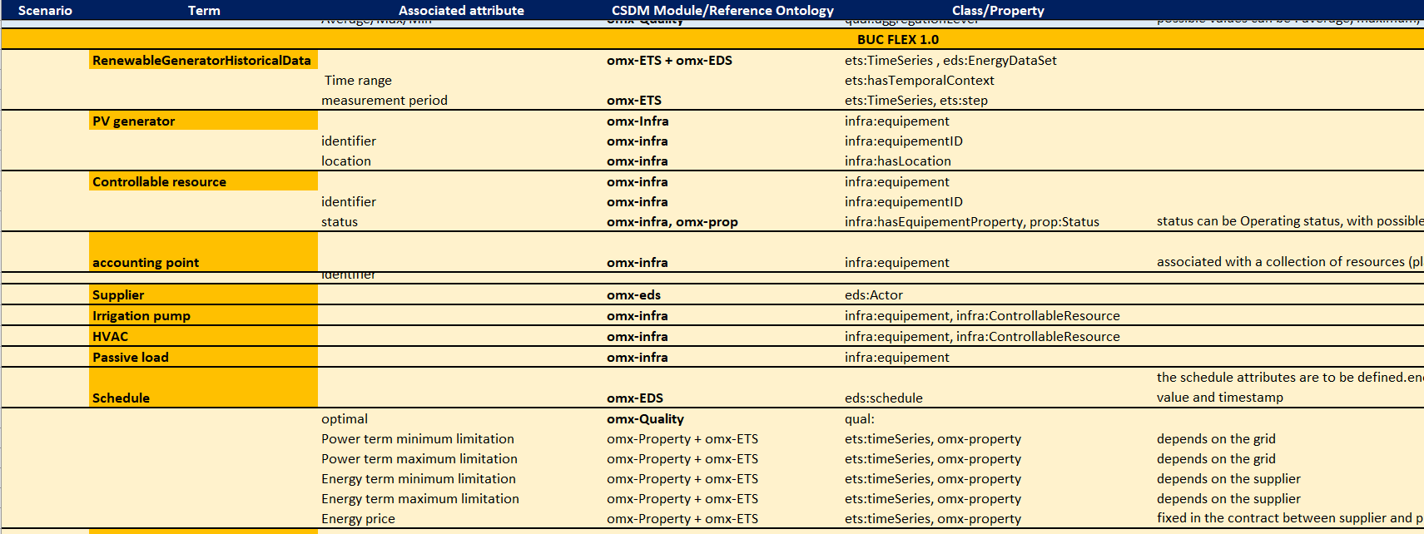
Last workshops

Slide 40
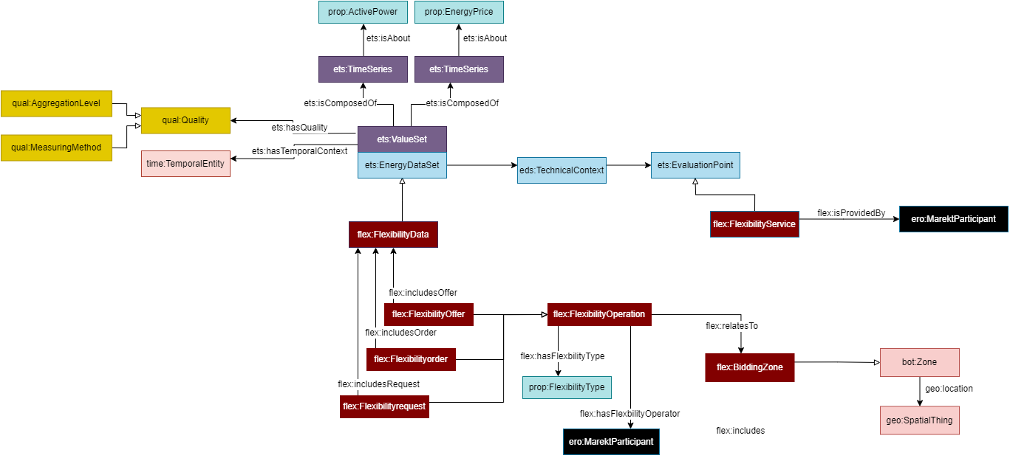
Flexibility Operations

Slide 41
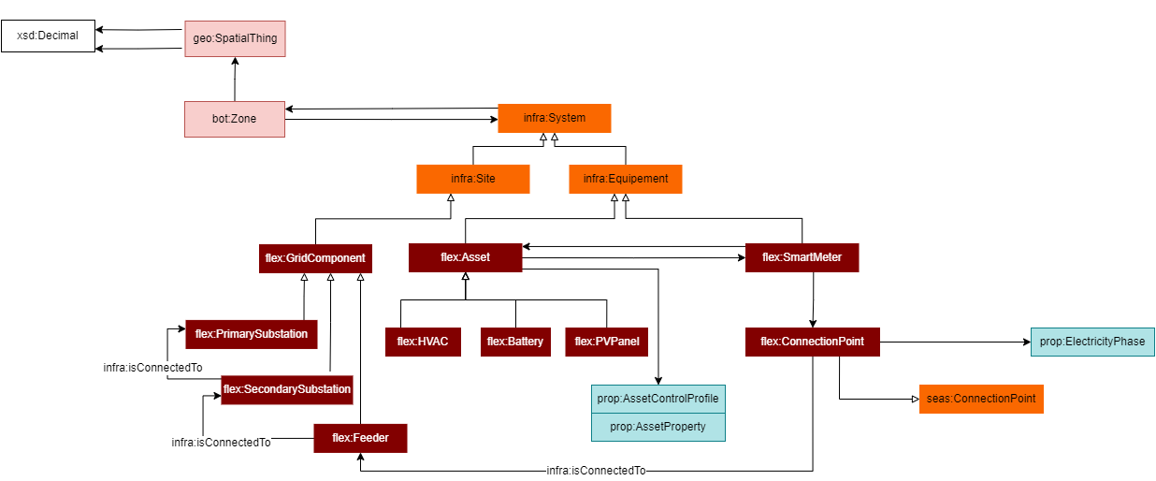
Infrastructure

Slide 42
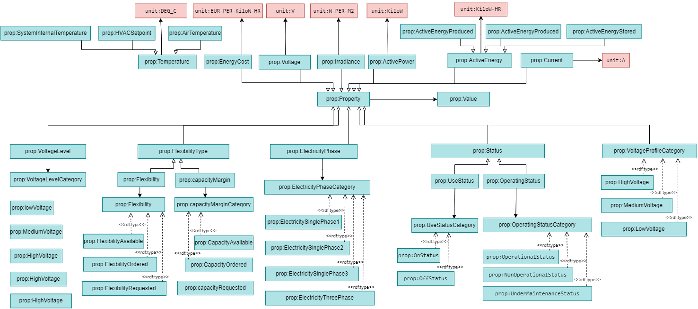
Flexbility Properties

Slide 43
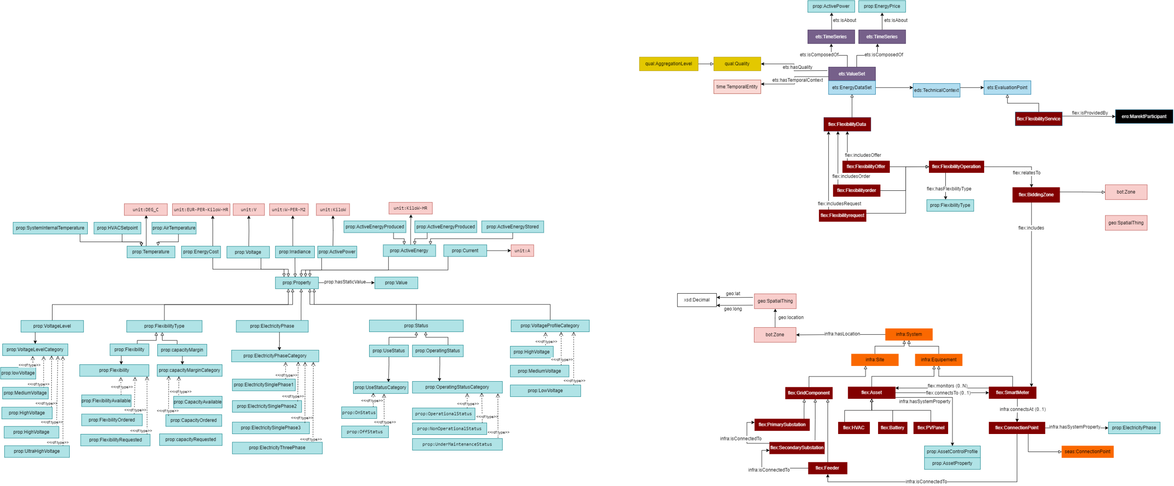
FLex

Slide 44
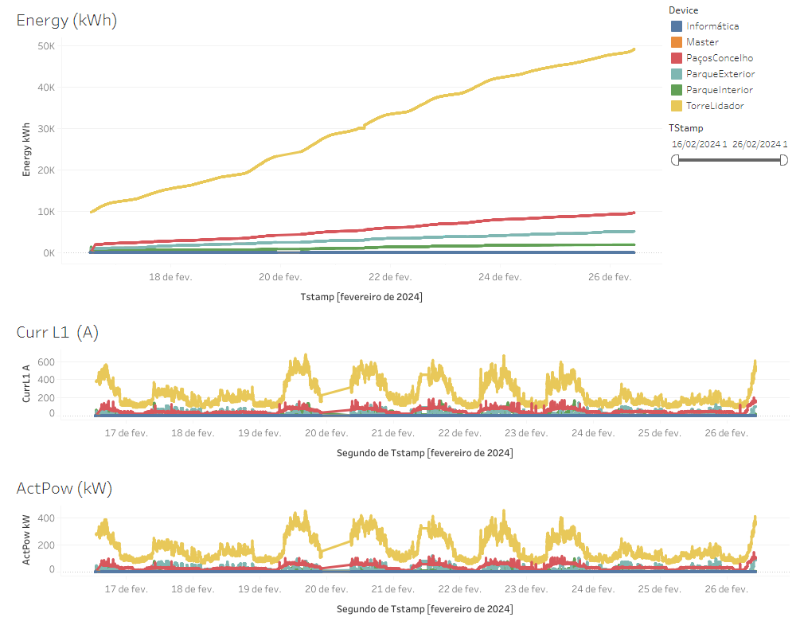
Data Mapping

Slide 45
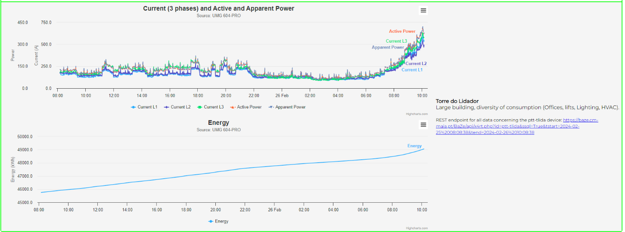
Data Mapping

Slide 46
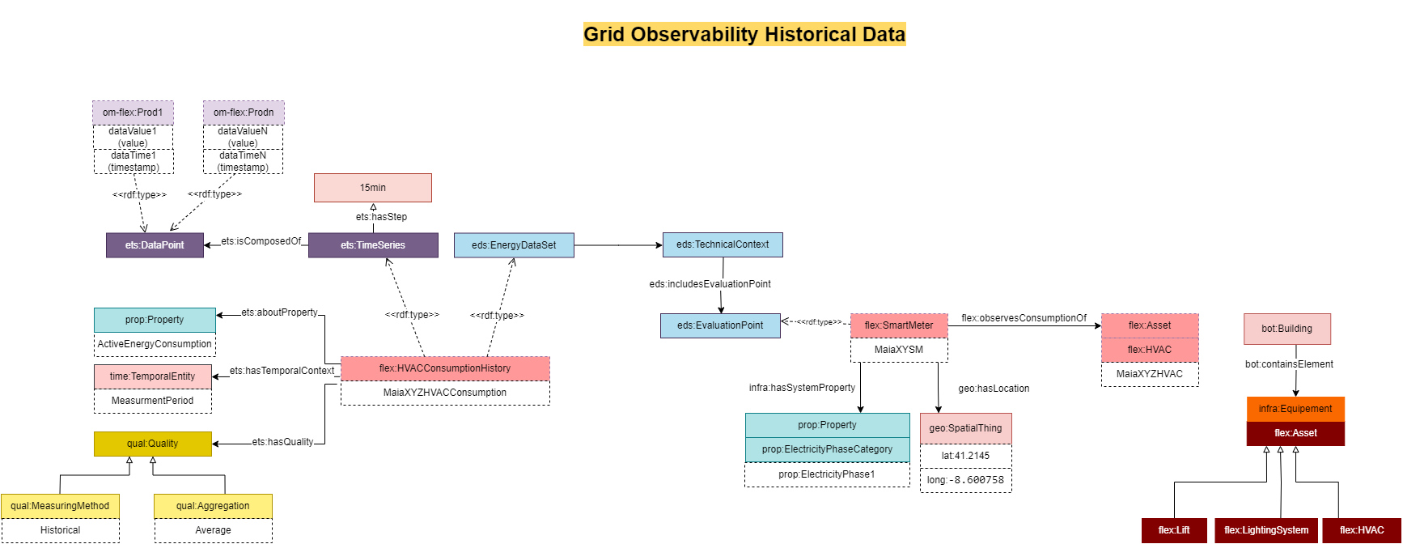
Data Mapping

Slide 47
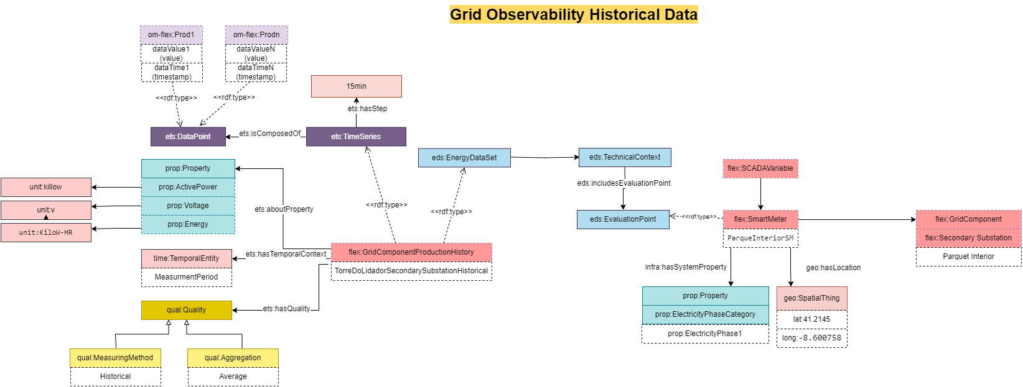
Data Mapping

Slide 48
Data Pipelining in Omega-X
Quality Report
Semantic Validation
(SHACL, Reasoner, ..)
Publish
Publish
Data Consumer
Data Exchange
Knowledge Graph
Semantify
Semantify
Syntactic Validation
Conforms to
Ontology
Data Storage
Data Provider
Notes:
Usage of CSDM modules EDS et
Data Storage ?

Slide 49
CSDM Demo on Maia
# Energy production Time Series
:MaiaEnergyProd a ets:TimeSeries, ets:ValueSet, eds:eds:EnergyDataSet ;
ets:temporalContext :MaiaEnergyprodCoverage ;
eds:includesTechnicalContext :MaiaEnergyProdTC ;
eds:includesBusinessContext :MaiaEnergyBC . # Location
:GueifãesControlSystemLocation
a schema:PostalAddress ;
schema:addressCountry "Portugal" ;
schema:addressRegion "Maia" ;
schema:addressLocality "Piscinas Municipais de Gueifães" ;
geo:lat "41.215143" ;
geo:long "-8.600758" . # Temporal Context
:MaiaEnergyprodCoverage a time:Interval ;
time:hasBeginning [a time:Instant ; time:inXSDDateTimeStamp "2021-01-01T00:00:00"^^xsd:dateTimeStamp ] ;
time:hasDurationDescription [ a time:DurationDescription ; :years "1"^^xsd:integrer] . # Evaluation Point
:GueifãesControlSystem a eds:EvaluationPoint ;
eds:hasLocation :GueifãesControlSystemLocation . # Technical Context
:MaiaEnergyProdTC a eds:TechnicalContext ;
eds:hasEvaluationPoint :GueifãesControlSystem ;
eds:includesProperty :energyProduction . # Business Context
:MaiaEnergyBC a eds:BusinessContext .
Maia Dataset
Static Data
These values are captured by a meteorological station (ATMOS 41, cf. datasheet, located in "Cobertura Verde" (Lat: 41.234158, Lng: -8.623050), and updated to Maia Municipality data lake every 15.
These values are collected by the control system (located in "Piscinas Municipais de Gueifães" (Lat: 41.215143, Lng: -8.600758), and every day, by 10AM, we receive an email with a link for a xls file with the data from the previous day. This email is processed around 12AM, and, thus, by 12AM the data lake
Dynamic Data
Notes:
Usage of CSDM modules EDS et
Data Storage ?

Slide 50
CSDM Demo on Maia
Maia Dataset
maia:MaiaEnergyProd ets:isComposedOf [
a ets:dataPoint;
ets:dataValue "721.98";
ets:dataTime "2023-08-15T10:00:00"^^xsd:dateTime
], [
a ets:dataPoint;
ets:dataValue "522.61";
ets:dataTime "2023-08-15T10:15:00"^^xsd:dateTime
], [
a ets:dataPoint;
ets:dataValue "473.51";
ets:dataTime "2023-08-15T10:30:00"^^xsd:dateTime
], [
a ets:dataPoint;
ets:dataValue "94.78";
ets:dataTime "2023-08-15T10:45:00"^^xsd:dateTime
], [
a ets:dataPoint;
ets:dataValue "551.71";
ets:dataTime "2023-08-15T11:00:00"^^xsd:dateTime
], [
a ets:dataPoint;
ets:dataValue "610.56";
ets:dataTime "2023-08-15T11:15:00"^^xsd:dateTime
Static Data
These values are captured by a meteorological station (ATMOS 41, cf. datasheet, located in "Cobertura Verde" (Lat: 41.234158, Lng: -8.623050), and updated to Maia Municipality data lake every 15.
These values are collected by the control system (located in "Piscinas Municipais de Gueifães" (Lat: 41.215143, Lng: -8.600758), and every day, by 10AM, we receive an email with a link for a xls file with the data from the previous day. This email is processed around 12AM, and, thus, by 12AM the data lake
Dynamic Data
Notes:
Usage of CSDM modules EDS et
Data Storage ?

Slide 51
Thank you!
Keep up with omega-x.eu
Omega X
@Omega_X_EU

